Slide 1
Nearest Hazardous Objects
Hazardous objects that are nearest to Earth

Slide 2
Business Task
A government own agency wants to figure out what to set their instruments or what devices they need to watch out for potentially hazardous astro objects closest to Earth. Explore data collected from NASA to find out what measurements and values that would deem an astro object dangerous.

Slide 3
Measurements
est_diameter_min: the minimum diameter estimated in kilometers
est_diameter_min: the Maximum Estimated Diameter in Kilometers
relative_velocity: the velocity that is relative to Earth
miss_distance: the distance in Kilometers missed the Earth
absolute_magnitude: the intrinsic luminosity which is the measure of brightness based on the distance of a star and the object

Slide 4
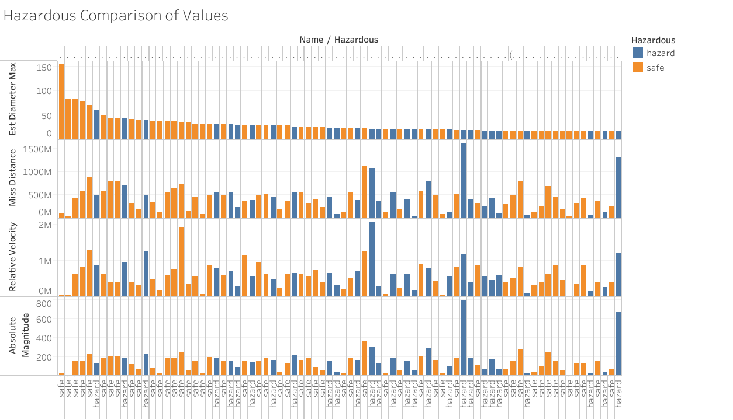
Data Tables
Shows how all over the place the data is when comparing them to each other.
No clear indication of what combo of data shows that they are hazardous
Shows that there is no correlation between values
One value being smaller or larger does not affect the other

Slide 5
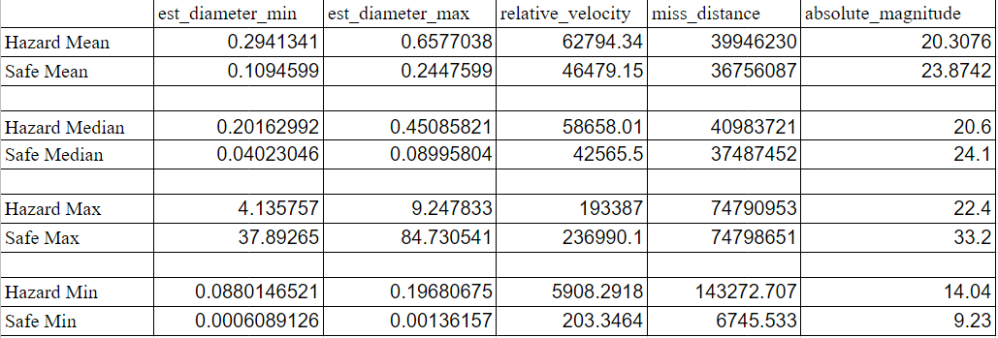
Aggregate Data

Slide 6
Final Points
With the visuals it can be seen that some hazard and safe objects have value that are close in numbers, making it not clear on the difference between the hazard and safe objects.
The aggregations of each value from the descriptive data analysis portion does give a better idea of what makes an object hazardous.
Showing hazard objects tend to have higher averages in all values except for absolute magnitudes.

Slide 7
Recommendations
We can conclude that the observers of celestial objects should keep watch of the diameter, velocity, distance, and the absolute magnitude.
The higher the values are in the diameter, velocity, and distance, the more hazardous the objects can be. This combined with checking the absolute magnitude where the lower values is more common with a hazardous object.
Get devices that can not only take a clear image of the object but also be able to measure the distance of the object.
The device should also take several pictures and record the time the pictures were taken since the velocity of the object can be more accurately calculated with these values.

Slide 8
Additional Information
It would have been helpful if there was a way to figure out the mass of the object.
This would have given us another value that to look out for and see if that can have an effect in determining if an object can be hazardous.
It could also give us more accurate values in figuring out the object's velocity and whether it is being affected by the other solar masses in our solar system. Though I can see how difficult that can be if there is no way to get a sample of the object.

Slide 9

Thanks!
Contact us:
Your Company
123 Your Street
Your City, ST 12345
no_reply@example.com
www.example.com

